Slide 1
Coupled Resonator Review
January 19, 2018

Slide 2
Theoretical Data

Slide 3
Experiment 1
3 inch Diameter Pipe
Speaker head approximately same diameter as pipe
Coupled 50mL Helmholtz Resonators
Frequency sweep from 20Hz to 2kHz using speaker
256 point per decade
Gain response recorded using audio analyzer
Reference taken: Pipe with no resonators attached
Reference data subtracted out of each experimental run data
Points label in each of the following plots indicates the theoretical resonance locations according to the Theoretical Data

Slide 4
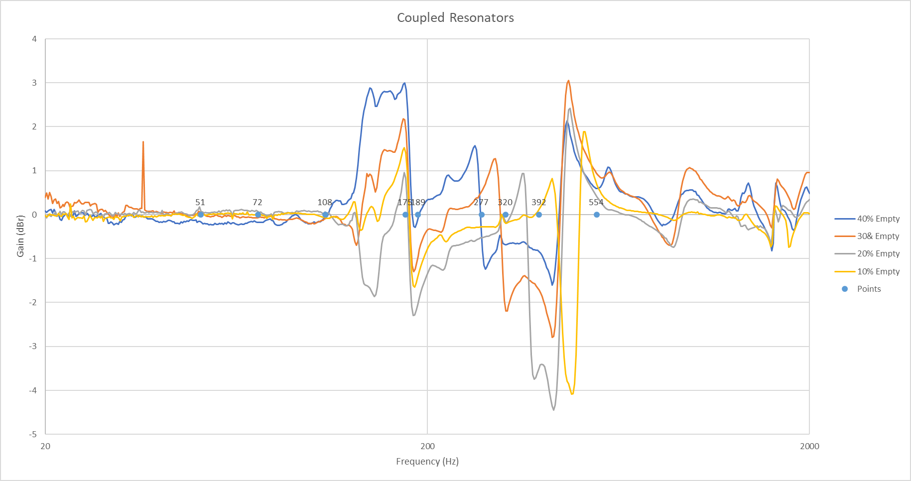
Large Pipe – Log Scale

Slide 5
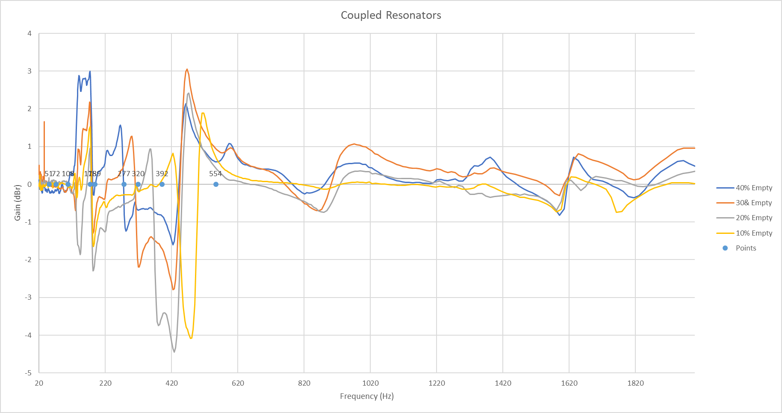
Large Pipe – Linear Scale

Slide 6
Conclusion – Experiment 1
Individual resonances are mostly present
Coupled resonances are not substantially present

Slide 7
Experiment 2
1 inch Diameter Pipe
Note: Speaker head ~3 in diameter, therefore larger than pipe
May cause inconsistency
Coupled 50mL Helmholtz Resonators
Frequency sweep from 20Hz to 2kHz using speaker
256 points per decade
Gain response recorded using audio analyzer
Reference taken: Pipe with no resonators attached
Reference data subtracted out of each experimental run data
Points label in each of the following plots indicates the theoretical resonance locations according to the Theoretical Data

Slide 8
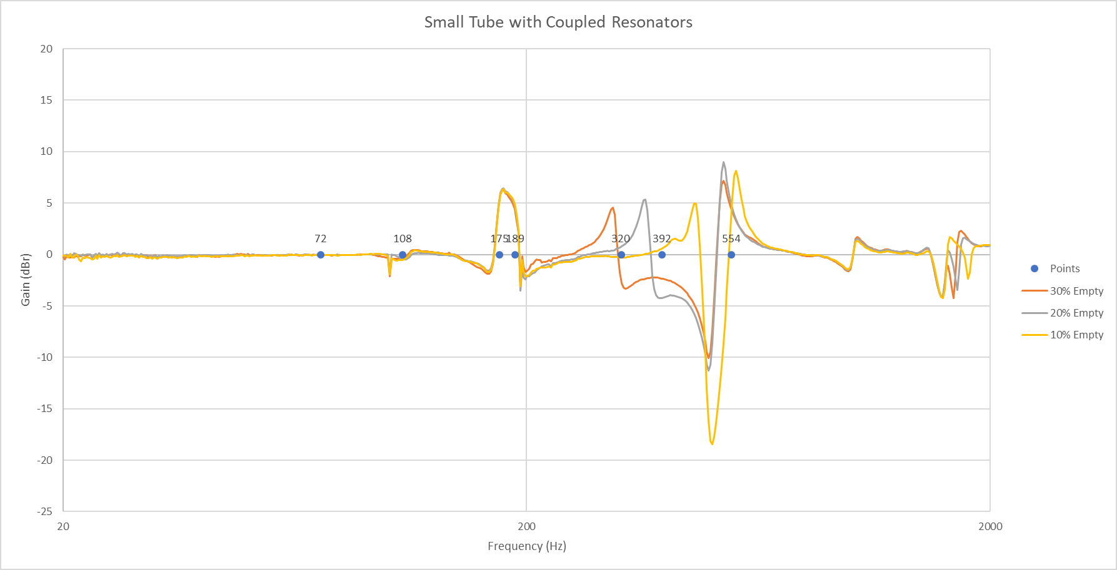
Small Pipe – Log Scale

Slide 9
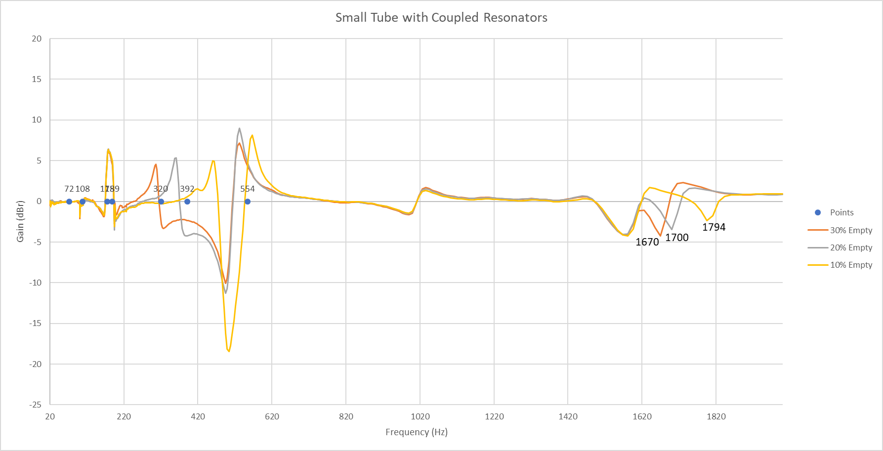
Small Pipe – Linear Scale

Slide 10
Conclusion – Experiment 2
Individual resonances are mostly present
Coupled resonances are not substantially present
Interesting behavior towards end: 1600Hz – 1800Hz range
Three absorption peaks present
Unknown cause

